Slide 1
Joint Project Defense
Sprout
June 2020

Slide 2


Slide 3
MEET SPROUT

Slide 4

What is Sprout?
Focus on social change
Vision:
Transform how we grow, share, and consume our food.
Mission:
Create a mutually beneficial relationship between local farmers, customers, and the environment through fair exchange and shared farm experience.

Slide 5






Meet the Team
Ariston Lim
Indonesia
Business Analyst
BDMA Masters Student
Julio Candela
Peru
Data Scientist
BDMA Masters Student
Nejada Karriqi
Albania
Software Engineer
Data Science Master Student
Valdemar Hernández Siles
Mexico
Digital Systems Engineer
BDMA Masters Student
Hung Nguyen
Vietnam
Data Scientist
BDMA Masters Student

Slide 6
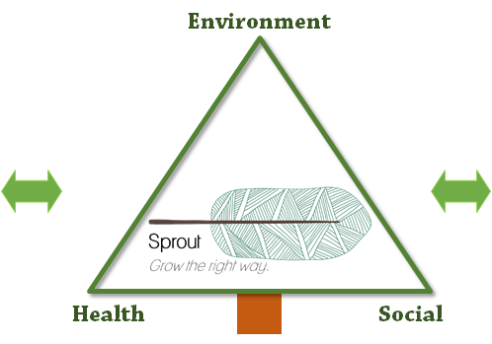


Sprout Experience
Farms in Barcelona
Many farms within 150km
Good distribution channels
Variety of products
Customers
Age 18-25: Care for health , environment and experience
Age 25-35: Bigger tickets
Prone to use online channel.
😀 Social, environmental and healthy brand → Sprout
😀 Start as a niche and grow the right way with customers and farmers
Notes:
150km: It’s possible for users to visit.
Turn into a start competitor

Slide 7

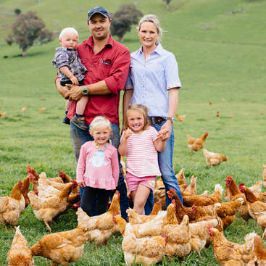
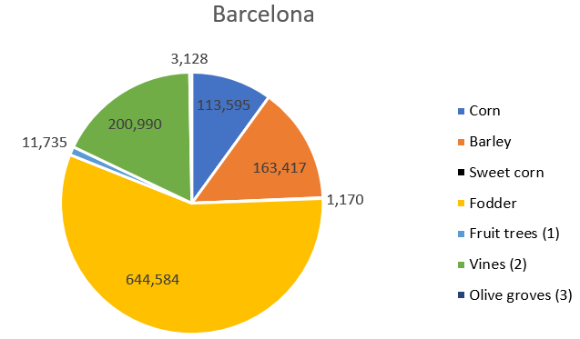

Products
Baskets of fresh products
Farming experience
Notes:
https://www.idescat.cat/pub/?id=aec&n=444&lang=en
In Sprout, we offer 2 main products,
overview of what kinds of crop growing in Spain. This is not a complete list
also depends on the farms and the seasons
Customized baskets:
The product selection is done by the customer or pre-customized by us
Of course, to be environment friendly, products will be packed with recyclable and eco friendly materials.
The minimum weight for delivery is 5kg
----------------
FE makes us stand out from our competitors
Farming experience: Nowadays, the word “organic” has been overused and sometime you dont believe in what you heard or read,
With Sprout, People can experience being a part of farming process (planting/harvesting)
They can ask questions regarding the products and farming processes.
Educational activities will be held to for kids.
The lunch prepared with farm’s products will be served for them (towards a payment).
They can buy cheaper products during their visit.

Slide 8
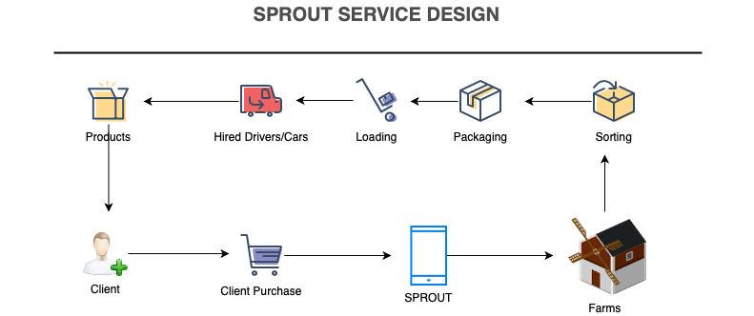
Service Design and Operations Plan
Notes:
Clients go our app to make some purchases
Our customers can also subscribe a specific basket to have it delivered weekly
Once they checked out, the orders go to the farms. They start collecting and packaging the ordered baskets and then wait for our cars come to pick it up and deliver to our customers.

Slide 9
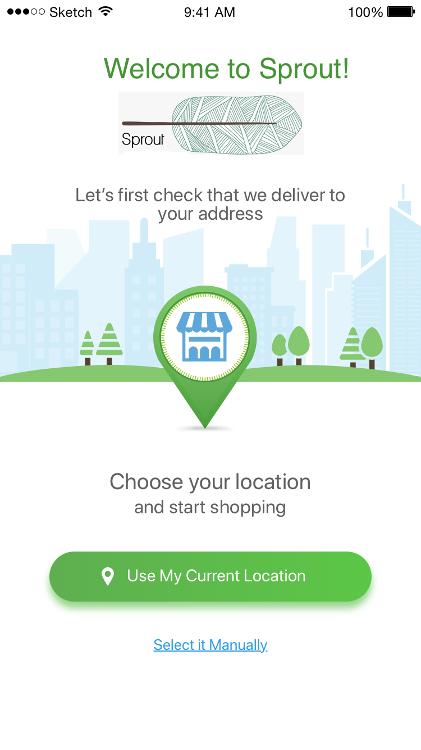
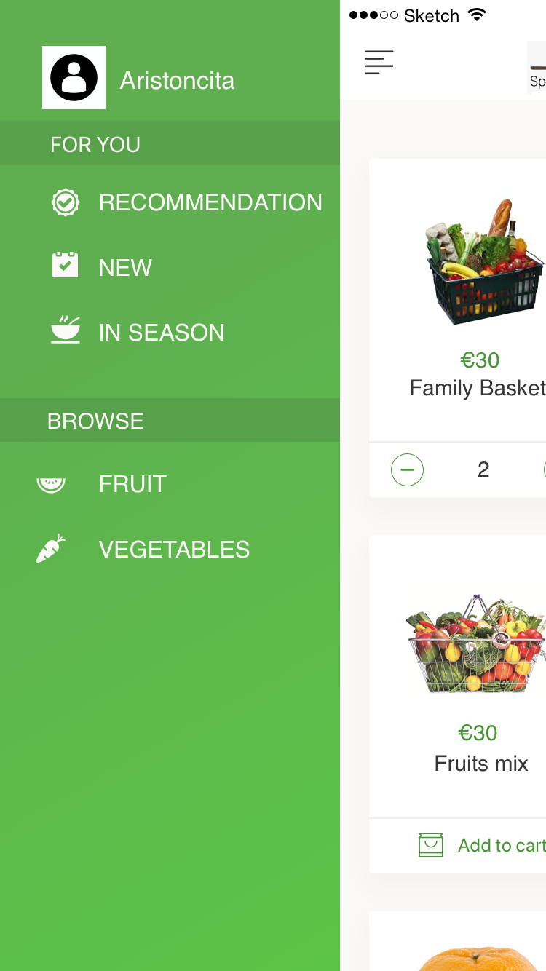
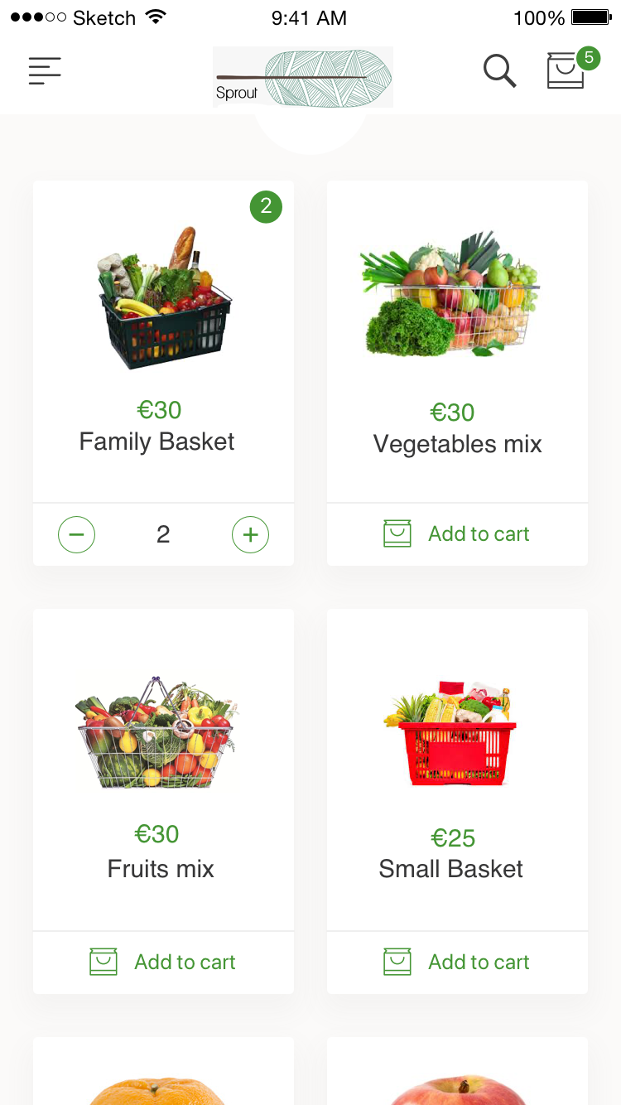
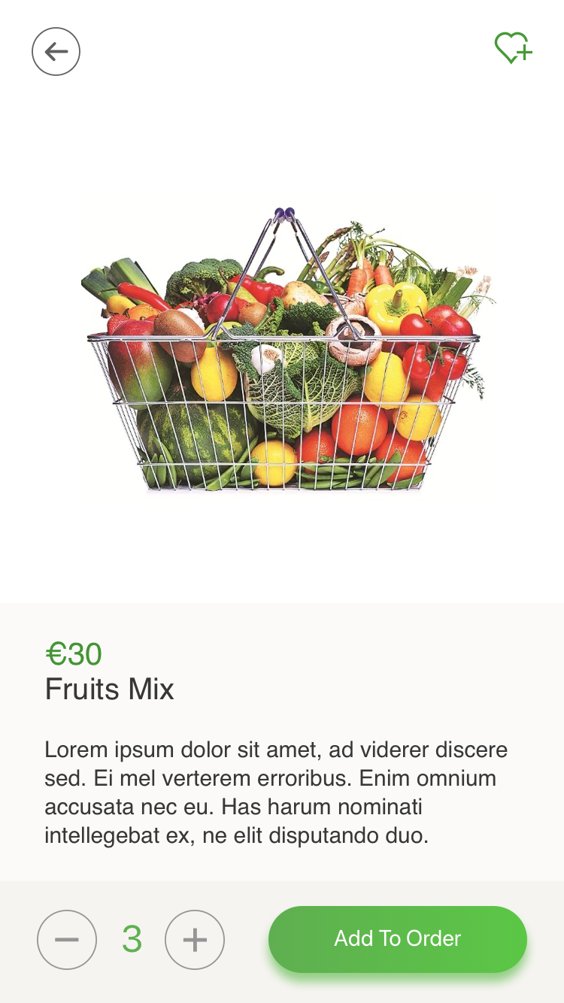
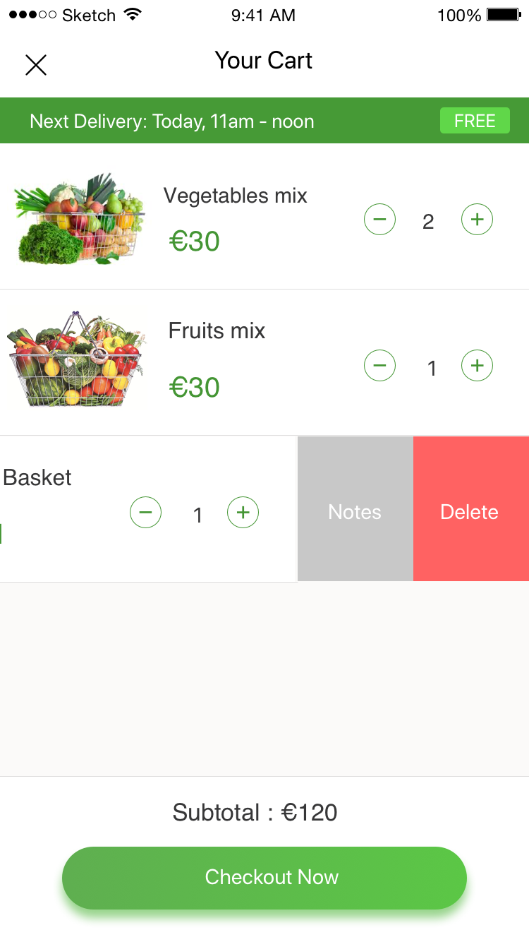
SPROUT Application Prototype
Notes:
Our SPROUT mobile app will be available on IOS and Android platforms. These are some main screens on our app.
Once the users launched the app, they need to choose the location that they want their order to be delivered to
They can navigate between different categories of products. We also have a section for recommended products which I will explain how it works in the next slide
We have many kinds of baskets which have different size, types of products, …
After putting baskets of products to the cart, they can check out to proceed to the delivery phase

Slide 10
PURPOSE STATEMENT
Notes:
Data generated from inside the company, such as orders placed by customer and customer feedback for specific products, will be analyzed to obtain insight on what products are preferred by our customers depending on their purchase history and their feedback to always offer the best selection of products to our customers.
Reliable option for its customers, and these results will help us in that regard in two fronts; first, the company will be able to maintain steady sales by offering the best set of products to each customer, and second, the company will be able to take action to cover the demand for its best selling products

Slide 11

How can Sprout benefit from Big Data?
Analyze data to obtain insight
Orders
Customer Feedback
Reliable for customers
Offer the best products to each customer
Cover the demand for best selling products
Notes:
Data generated from inside the company, such as orders placed by customer and customer feedback for specific products, will be analyzed to obtain insight on what products are preferred by our customers depending on their purchase history and their feedback to always offer the best selection of products to our customers.
Reliable option for its customers, and these results will help us in that regard in two fronts; first, the company will be able to maintain steady sales by offering the best set of products to each customer, and second, the company will be able to take action to cover the demand for its best selling products

Slide 12
ARCHITECTURE

Slide 13
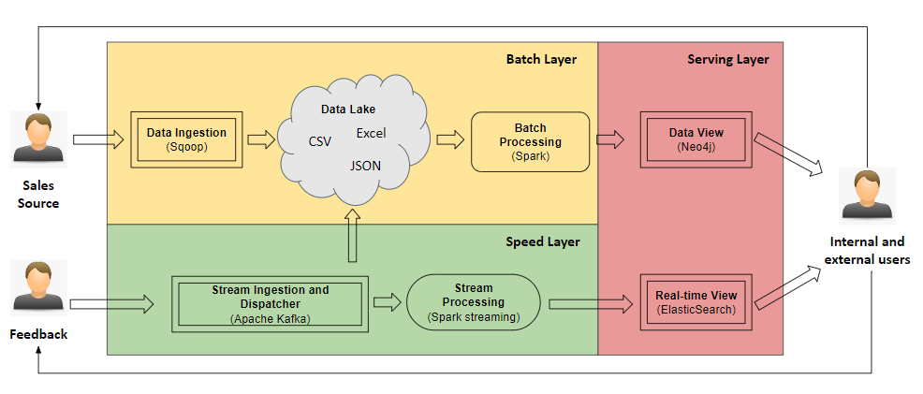
SPROUT Data Architecture
Notes:
Software Reference Architecture is based on Bolster.(without the semantic layer, it is similar to a lambda architecture)
Batch Layer: For storing and processing massive volumes of data.
Batch Ingestion: Periodically ingest data.
Data Lake: Managing large amounts of data.
Batch Processing: Transforms and runs iterative algorithms over the data stored in the Data Lake to shape them accordingly to the analytical needs of the use-case at hand.
Speed Layer: Deals primarily with Velocity. Its input are continuous, unbounded streams of data with high timeliness.
Stream Ingestion: Message queue for raw data streams that are pushed from the data sources.
Dispatched: Not implemented. Validate that all ingested events follow the specified schema and determine whether to process data in a real-time manner or batch manner.
Stream Processing: Performing One-Pass Algorithms over the stream of events
Serving Layer: Holds transformed data ready to be delivered to end-users.
Batch View: Incremental approaches should be adopted to avoid unnecessary writes. Must provide a high-level query language, serving as interface with the Query Engine.
Real-time View: Needs to provide Low Latency Querying over dynamic and continuously changing data sets

Slide 14




Tool Selection
Data Ingestion: Sqoop
Batch Processing: Apache Spark
Graph Modelling: Neo4j
Stream Ingestion and Stream Dispatcher: Apache Kafka
Stream Processing: Spark Streaming
Real-time View: Kibana (ElasticSearch)
Notes:
Sqoop: Apache Sqoop is used for bulk data transferring between datastores. Raw sale data files will be moved to a data lake which contains a large amount of data coming from various sources.
Apache Spark: Large scale data processing.
Neo4j: To perform graph analytics, property graph and graph algorithms are better choices than knowledge graphs.
Apache Kafka: Tool to ingest streaming data. Capable of handling trillions of events a day.
Spark Streaming: Provides scalability, high-throughput, fault-tolerant stream processing.
Kibana: Visualize your live Elasticsearch data

Slide 15
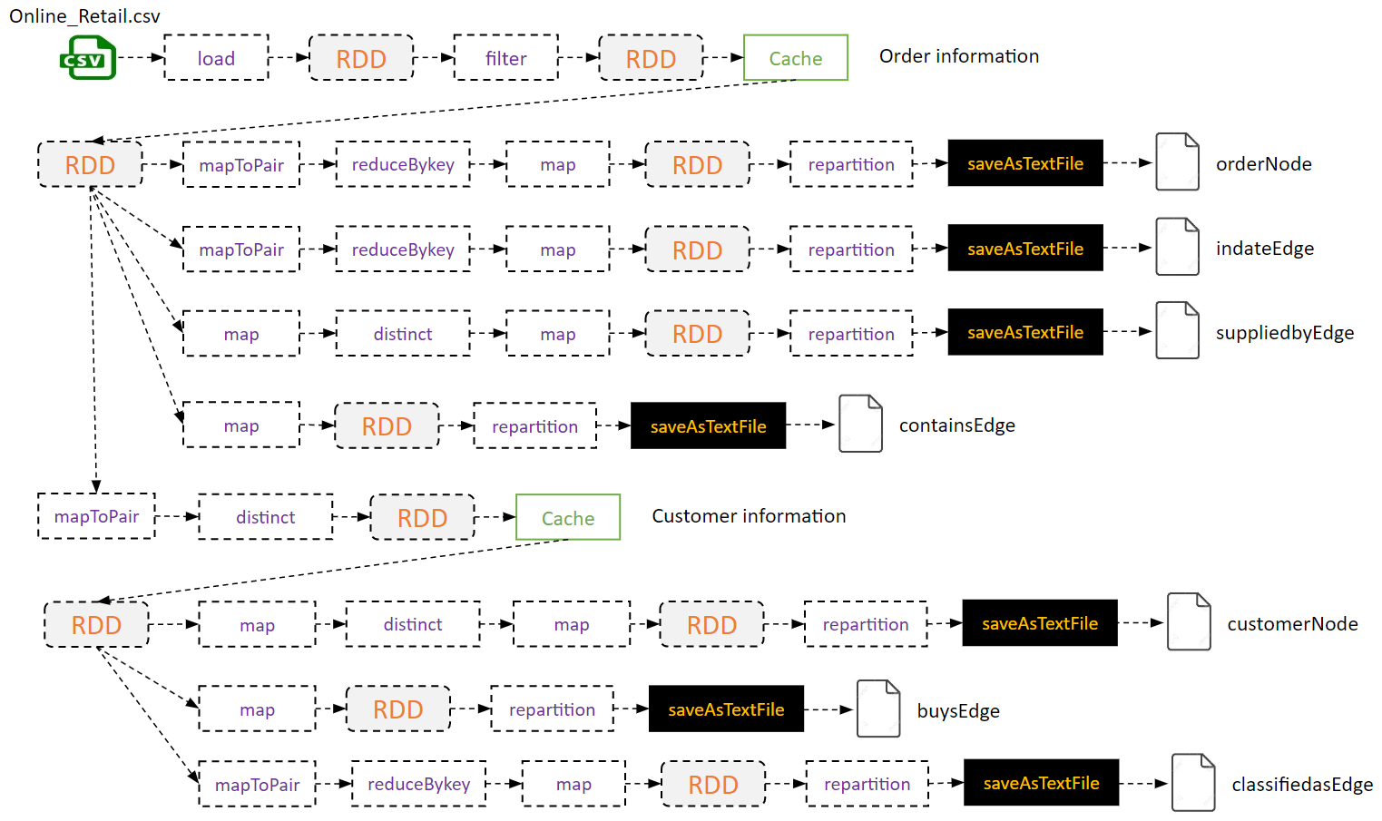
Batch Data Processing (Spark)
Transactions
EU Market prices
Feedback

Slide 16
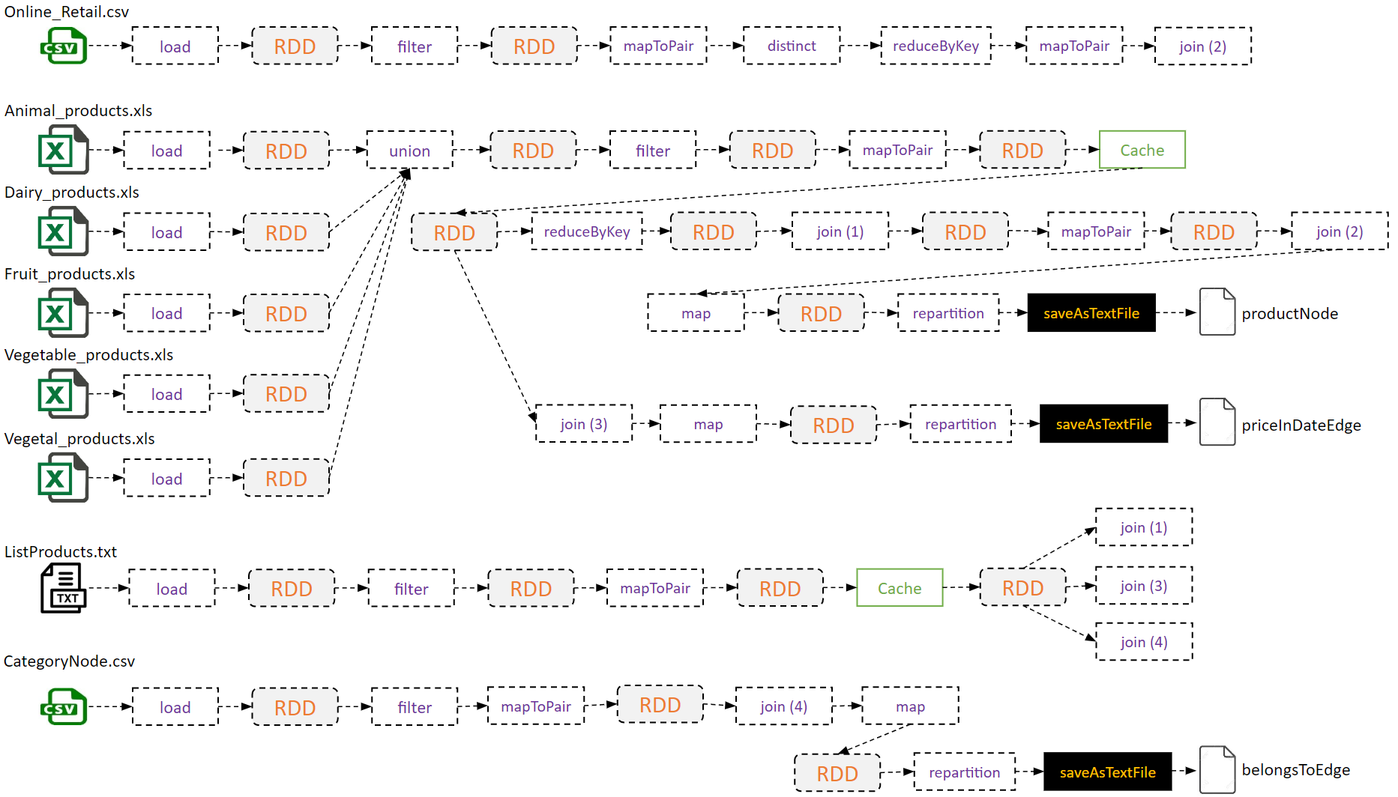
Batch Data Processing (Spark)
Transactions
EU Market prices
Feedback

Slide 17
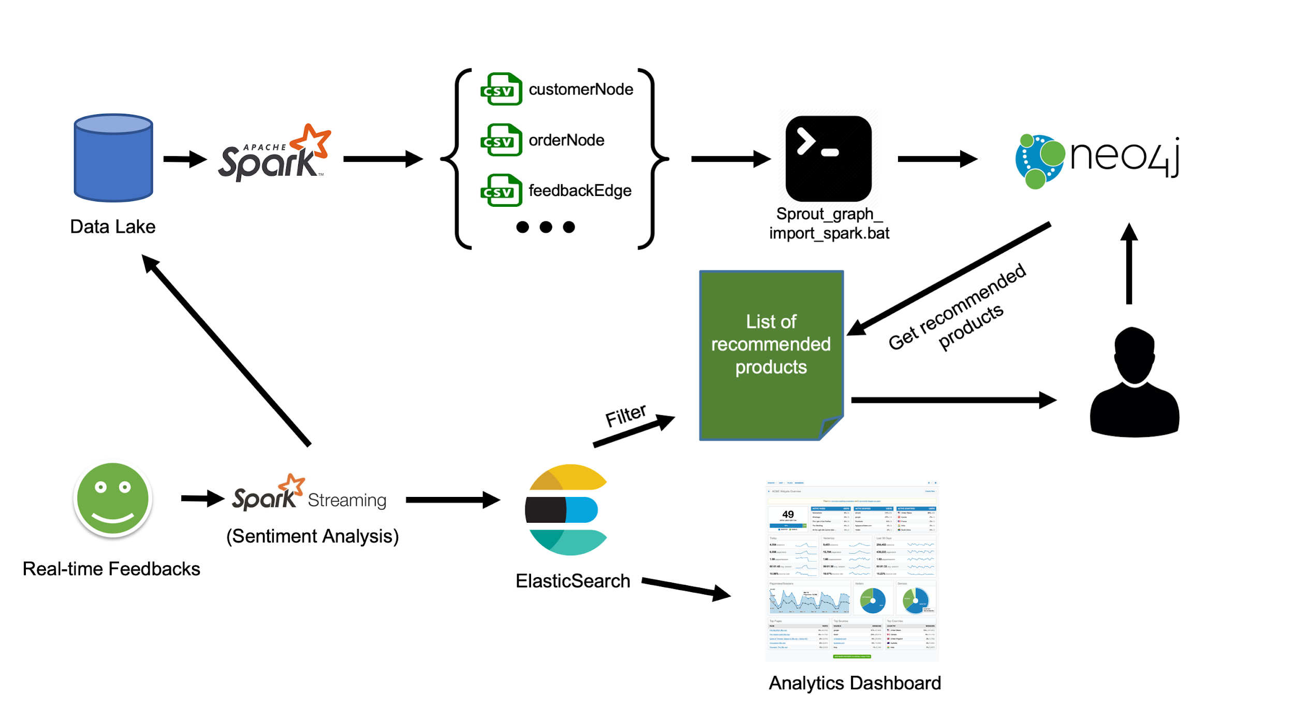
Implementation
Notes:
1000 daily orders per region after the first five years of operation.
Data sources: Market Prices from EU, Daily Orders, Customer Feedback, List of products, Municipalities
1000 comments/ratings per day
Data source: Customer feedback from Sprout’s app

Slide 18
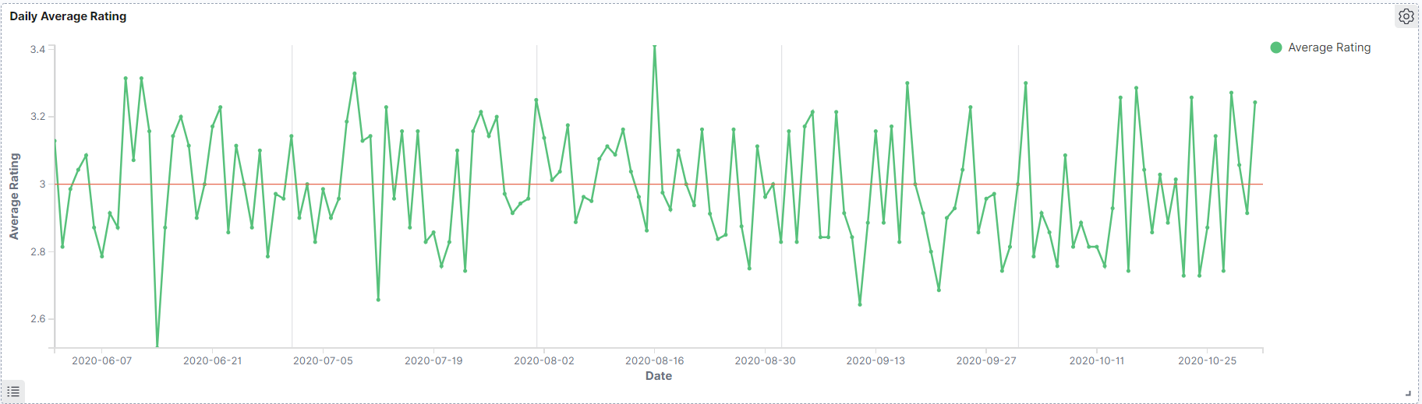
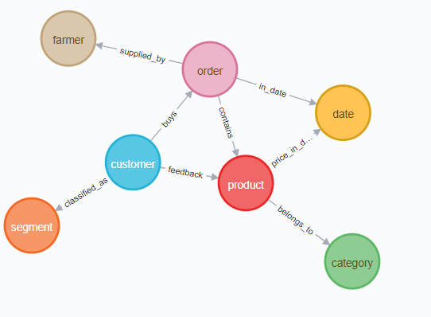
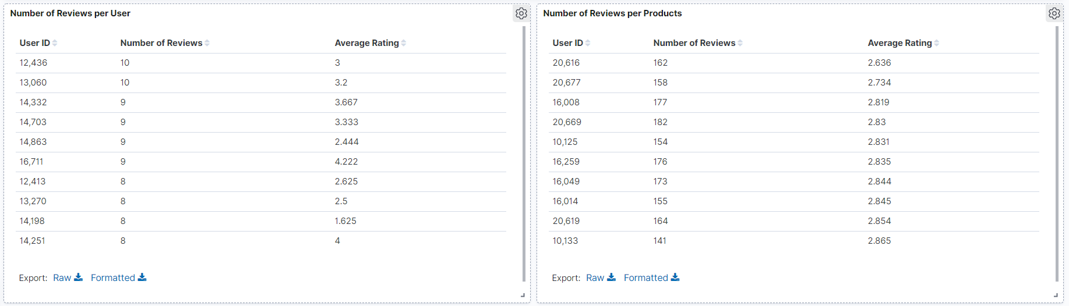
Batch View (Neo4j)
Real-time View (ElasticSearch)

Slide 19
GRAPH ANALYSIS

Slide 20
Property Graph: Neo4j
Use case:
Product recommendation
Best selling product
Notes:
graph offers a high level representation of the data model utilizing nodes, relationships and properties as well as traversal navigation to speed-up graph patterns and path queries in order to traverse the graph looking for recommendations of similar customers.

Slide 21
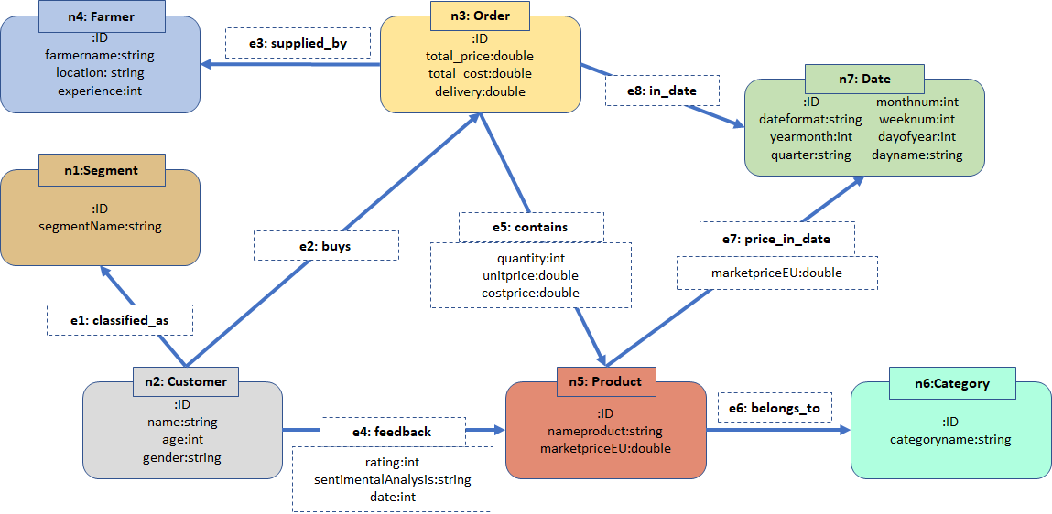
Graph Modelling (Neo4j)

Slide 22
Exploiting the Graph
Collaborative Filtering
Based on orders
Based on feedback and rating
Bestselling Product

Slide 23
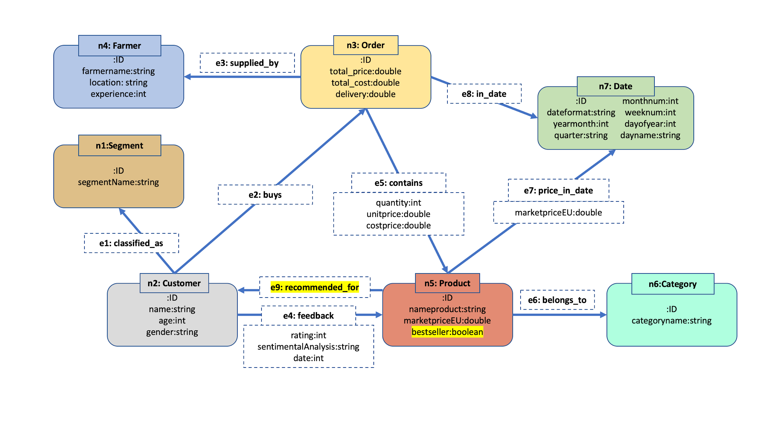
Updated Metadata

Slide 24
DEMO

Slide 25
THANK YOU!

